Slide 1


Common Core Planning for Content & Practice
Preparing Los Angeles Students for College and Career
Notes:
This afternoon we’ll be planning Common Core-style lessons, using our three phase structure.

Slide 2
The Standards for Mathematical Practice
Standards for Mathematical Practice
MP1 Make sense of problems and persevere in solving them.
MP6 Attend to precision.
MP2 Reason abstractly and quantitatively.
MP3 Construct viable arguments and critique the reasoning of others.
MP4 Model with mathematics.
MP5 Use appropriate tools strategically.
MP7 Look for and make use of structure.
MP8 Look for and express regularity in repeated reasoning.
Notes:
MP 1 & 6 extend throughout every math lesson. They represent overarching habits of mind exhibited by successful mathematicians.
MP 2 & 3 are described as reasoning and explaining.
MP 4 & 5 are summarized as modeling and using tools.
MP 7 & 8 are described as seeing structure and generalizing.
LAUSD has targeted MP3 as the 2012-2013 focus. MP 1 and 4 will be added as the 2013-2014 focus. For this reason, we’ll focus on MP 1, 3, & 4 as we plan our lesson today.

Slide 3
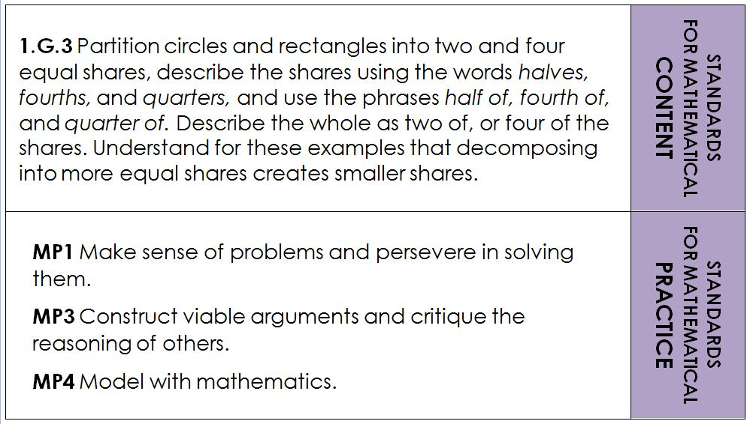
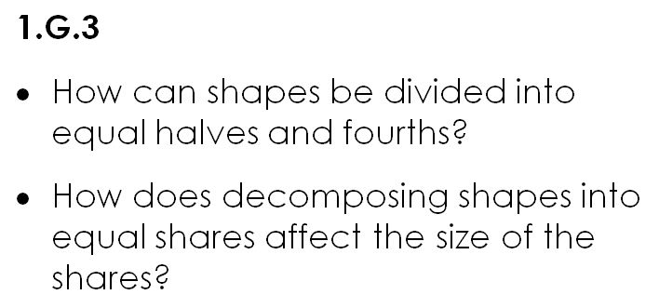
Think Pair Share What are some activities that might address 1.G.3 and the essential questions?
Notes:
Prior to exploring the activities listed in the Curriculum Map, participants brainstorm ways they might address the standard.

Slide 4
Three-Phase Structure
BEFORE
5 Minutes
DURING
AFTER
Activate prior knowledge
Review vocabulary
Pose the problem
Ensure that students understand the task
Notes:
4
Review the Before phase of the John Van de Walle Three-Phase Structure.

Slide 5
Three-Phase Structure
Let go!
Circulate as students independently work in pairs or groups
Ask questions to focus, assess, and advance student thinking
Decide which solutions will be selected for sharing
BEFORE
DURING
20 Minutes
AFTER
Notes:
5
Review the During phase of the John Van de Walle Three-Phase Structure.

Slide 6
Three-Phase Structure
Facilitate the sharing of two or more solution paths
Order selected solutions to help generate a mathematically productive discussion
Facilitate a student-centered discussion so that students:
Develop an understanding of the concept
Add on to and question solutions shared
Make connections between the solutions presented
Find generalized characteristics within the problem
Summarize the main idea and identify next steps, future problems
BEFORE
DURING
AFTER
15 Minutes
Notes:
6
Review the After phase of the John Van de Walle Three-Phase Structure.

Slide 7
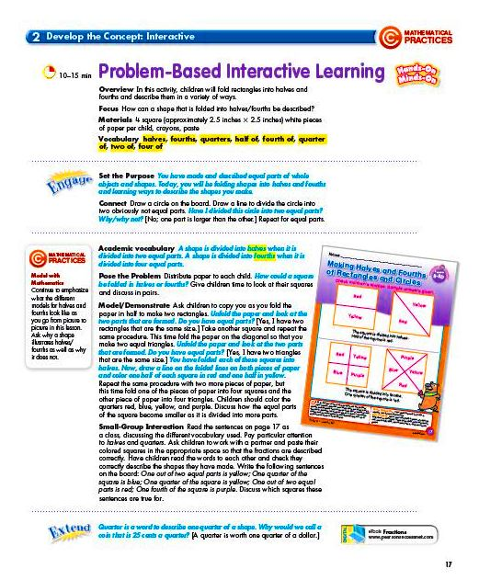
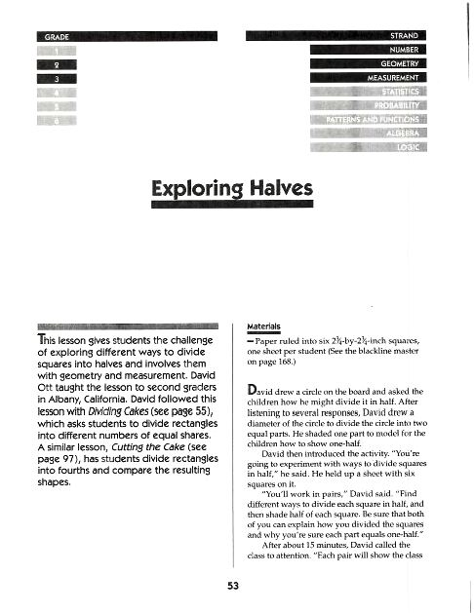
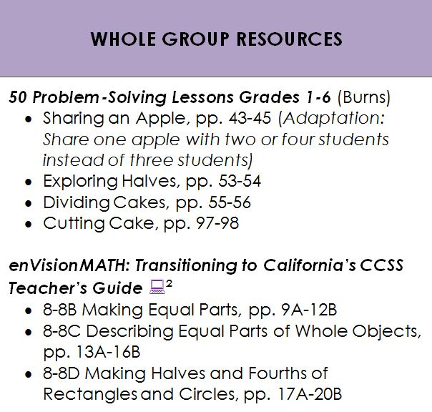
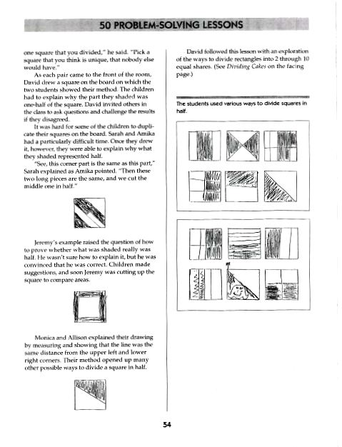
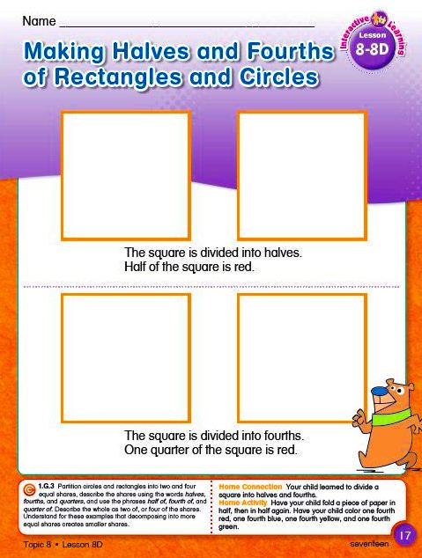
Resource Selection
Notes:
The Curriculum Map has resource suggestions to chose from. We’re working with one first grade standard, and one kindergarten standard today. We’ll be working in level-alike groups to create a CCSS lesson.
Review the 1.G.3 whole group resources and choose a lesson as a grade level team. Once you’ve selected a lesson, use the Lesson Planner as a guide to plan your CC activity for content and practice. Participants can choose which grade level to work with.

Slide 8
Grade Level Planning
In grade-level teams, complete the Common Core Math Lesson Planner
Chart your Three-Phase lesson
Each member of the grade-level team should be ready to present your activity
Notes:
Please take out the Common Core Math Lesson Planner from your packet. (Go through planner. Then read slide and discuss expectations. Questions?)

Slide 9
Gallery Walk
Count off in your team to 4
1s from each team meet at the same chart, 2s meet at another chart, etc.
The group member that helped create the poster explains their work to the rest of their group
The group rotates to the next poster when ready and the process repeats
Notes:
Explain process

Slide 10
Think Pair Share What are some ways the quote below relates to our work today?
These Standards are not intended to be new names for old ways of doing business. They are a call to take the next step.
- Common Core State Standards for Mathematics, Introduction, p. 5
Notes:
Please discuss in your group: What are some ways the quote relates to our work today?

Slide 11
Logistics
What do you present to the school site?
“Listening and Speaking” module
“CC Planning for Content and Practice” power point
How? Facilitator’s Guide in your packet
When? Grade Level Meetings

Slide 12
Expectations
All kindergarten and first grade teachers will teach a Common Core math lesson, or math lessons, during the spring semester of 2013.
All kindergarten and first grade teachers will be teaching all Common Core State Standards in the fall of 2013.
Notes:
Read slide. Questions?

Slide 13
Thank You
Notes:
Thank the participants for their time!

